Slide 1
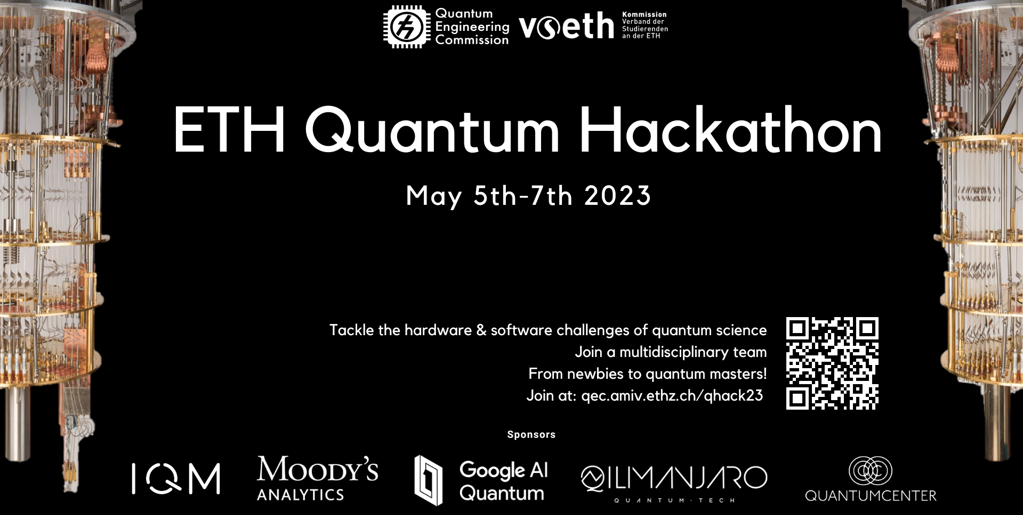
Quantum Hackathon
Solving Geometric Brownian Motion with Quantum Computers

Slide 2
PITCH
Reasons for investing in quantum:
By investing in quantum you are at the forefront of fintech innovation. This way you not only gain a foothold in the quantum space, a future billion dollar industry, but you also have the opportunity to identify opportunities faster and more efficiently by harvesting the computing power of quantum computers. Lastly, quantum computers can do more work using less resources cutting costs that potential supercomputers would incur. These three reasons are the key to unlocking sizeable potential increases in revenue growth and profit margin.

Slide 3
European Call Option Model
$$dS_{t}=μS_{t} dt+σS_{t}dW_{t}$$
$$dW_{t}=𝒩\left(0, 1\right)\sqrt{dt}$$
where
Want $𝔼\left[max⁡\left(S_{T}−100, 0\right)\right]$, the expected profit.

Slide 4
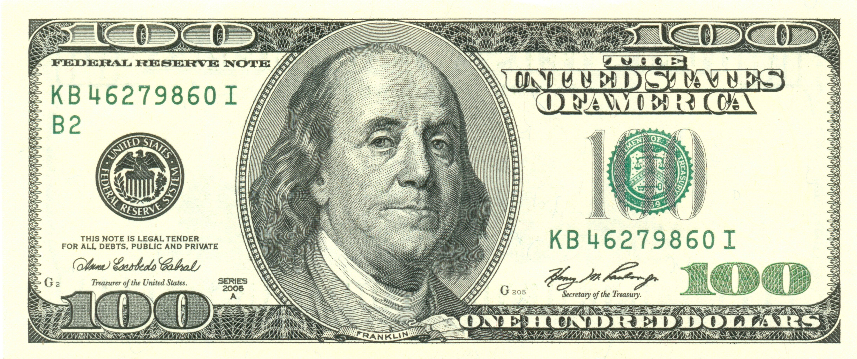
Be at the forefront
Large increases in computational power
Increases in revenue and profit
Less resources

Slide 5
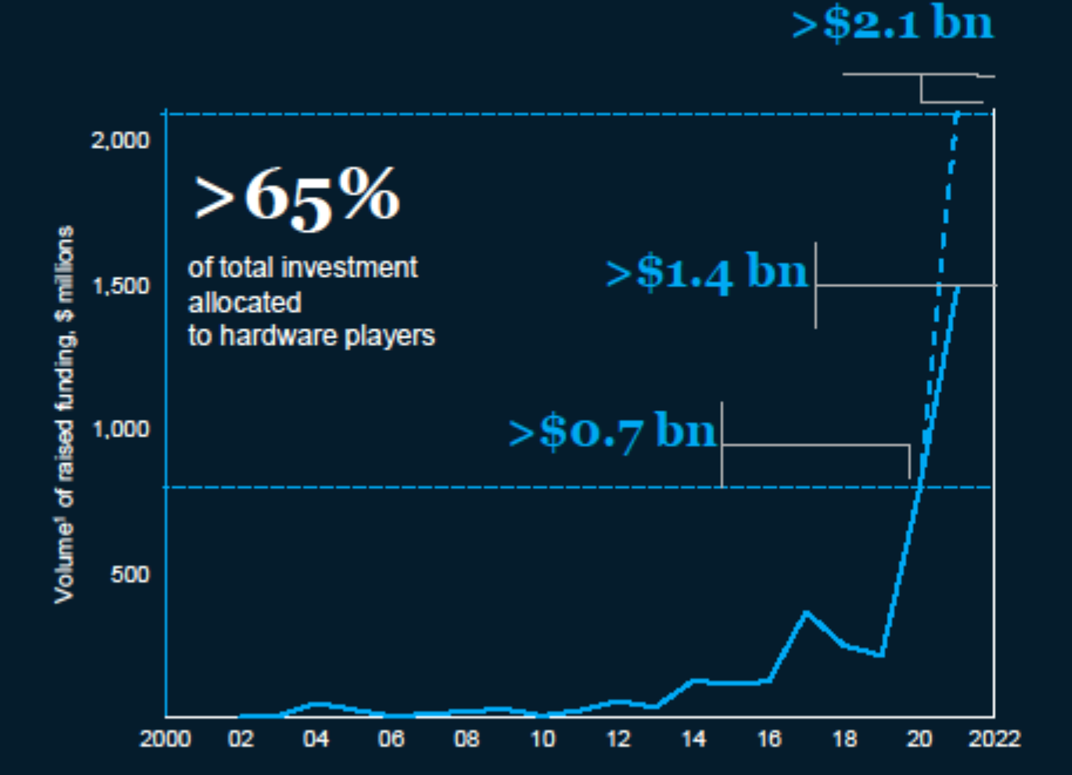
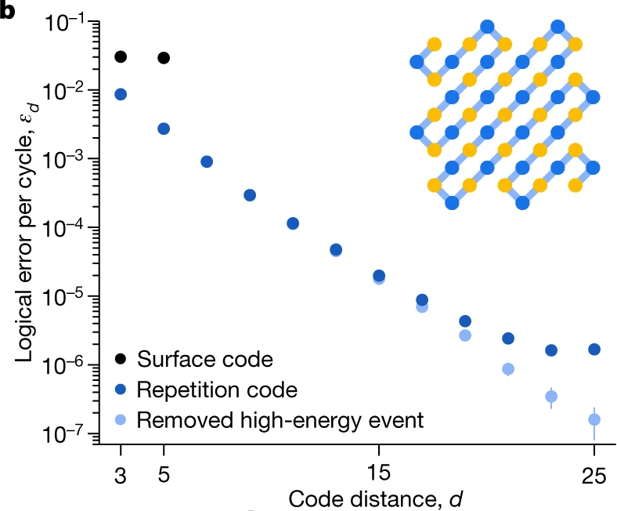
Roadmap
1.
Time
Initial devices
Initial sped up tasks
Setup research
Advanced applications
Fault tolerant quantum computers
Initial algorithms
Elementary QEC
1. McKinsey and Co. Article on Quantum Technology sees record investments progress on talent gap.
2. Google Inc. Nature 2023. Suppressing quantum errors by scaling a surface code logical qubit.
2.
Now, NISQ era
Later

Slide 6
Proof of Concept
Quadratic speed up of quantum task designed for the NISQ Era.
Method | Error
Quantum Monte-Carlo | 1/n
Classical Monte-Carlo | 1/√n
Error
Samples

Slide 7
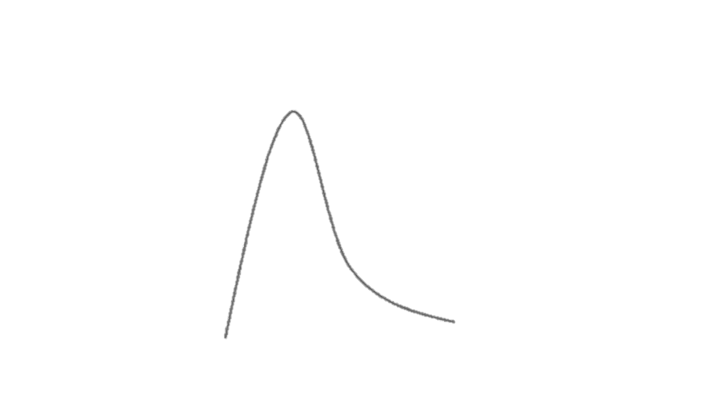
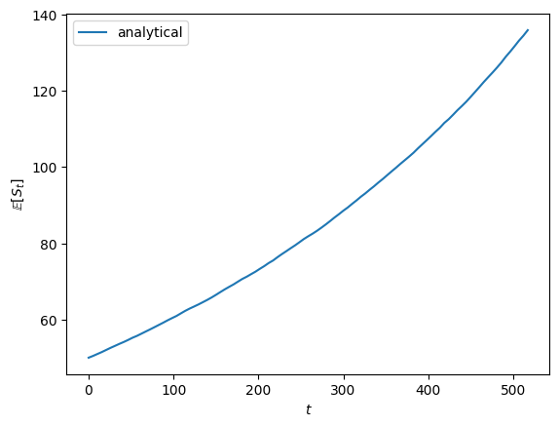
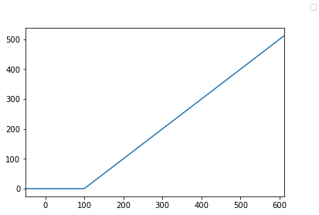
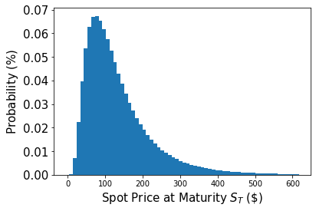
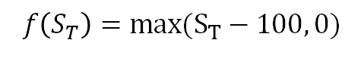
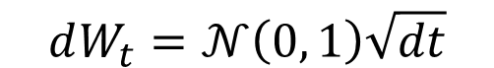
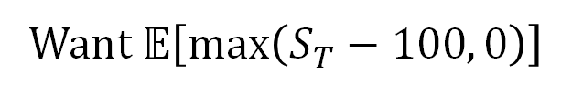
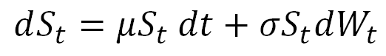
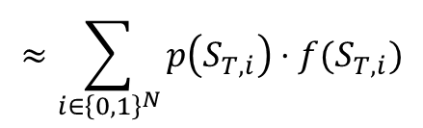
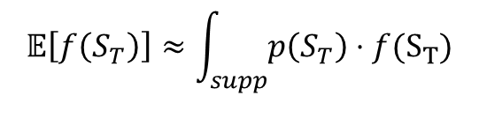
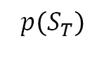
The Problem
$$dS_{t}=μS_{t} dt+σS_{t}dW_{t}$$
with
$$dW_{t}=𝒩\left(0, 1\right)\sqrt{dt}$$
Want $𝔼\left[max⁡\left(S_{T}−100, 0\right)\right]$
Lognormal distribution
$$𝔼\left[f\left(S_{T}\right)\right]≈\int_{supp}{p\left(S_{T}\right)⋅f(S_{T})}$$
$$≈\sum_{i∈{\left\{0,1\right\}}^{N}}{p\left(S_{T,i}\right)⋅f(S_{T,i})}$$
$$p\left(S_{T}\right)$$
$$f\left(S_{T}\right)=max⁡(S_{T}−100, 0)$$

Slide 8
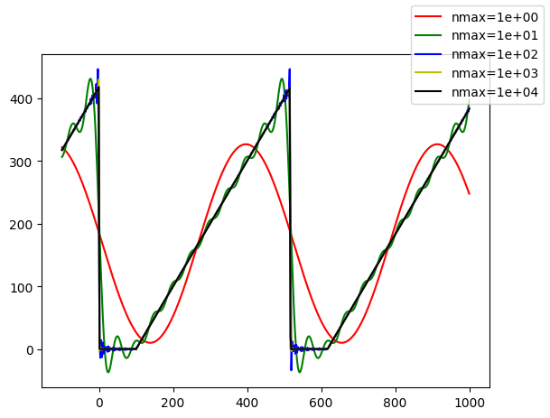
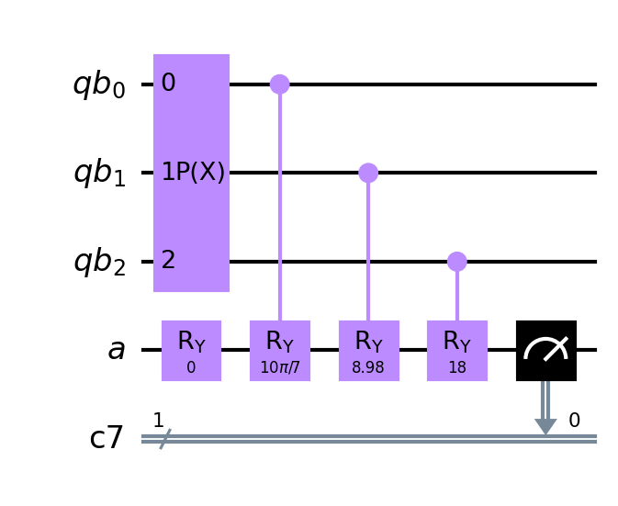
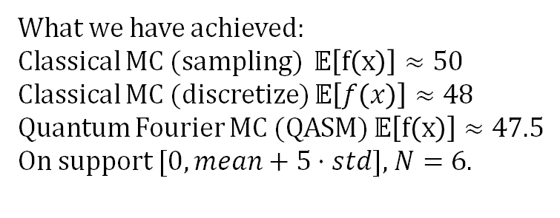
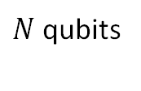
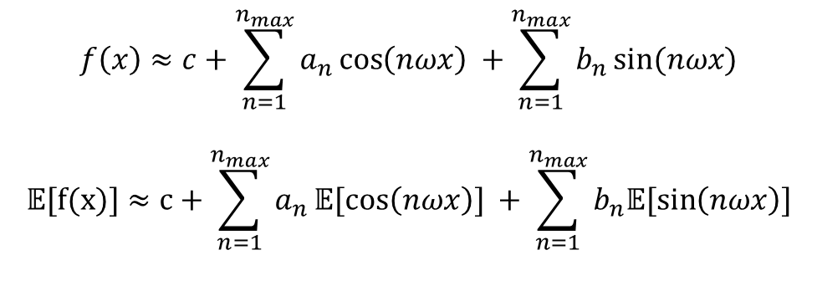
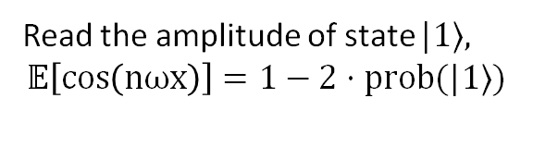
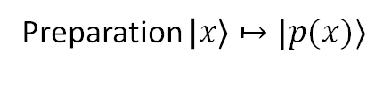
Quantum Fourier Monte Carlo
$$f\left(x\right)≈c+\sum_{n=1}^{n_{max}}{a_{n}\cos\left(nωx\right) }+\sum_{n=1}^{n_{max}}{b_{n}\sin{(nωx)}}$$
$$𝔼[f(x)]≈c+\sum_{n=1}^{n_{max}}{a_{n}𝔼[cos\left(nωx\right)] }+\sum_{n=1}^{n_{max}}{b_{n}𝔼[\sin\left(nωx\right)]}$$
Preparation $\left|x\right\rangle ↦|p(x)⟩$
$N$ qubits
What we have achieved:
Classical MC (sampling) $𝔼\left[f\left(x\right)\right]≈50$
Classical MC (discretize) $𝔼\left[f\left(x\right)\right]≈48$
Quantum Fourier MC (QASM) $𝔼\left[f\left(x\right)\right]≈47.5$
On support $[0,mean+5⋅std]$, $N=6$.
Read the amplitude of state $|1⟩$,
$$𝔼\left[\cos\left(nωx\right)\right]=1−2⋅prob(|1⟩)$$

Slide 9
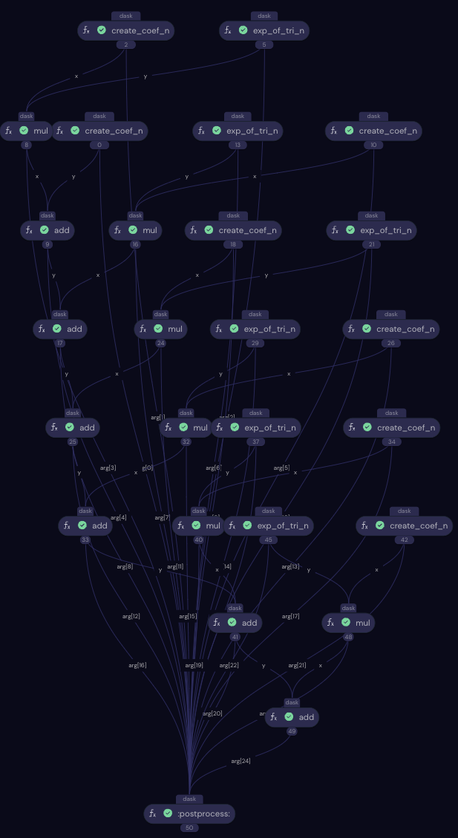
Optimizations
Computation of coefficients can be executed in parallel:
Quantum computations and classical computations of coefficients executed simultaneously.
We realized it in open-source covalent:
Each computational step is one electron.
Combine the electrons into common lattice.
Quantum computations
classical computations
executed simultaneously

Slide 10
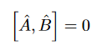
Parallellization of processes
Latency
Two processes can be executed simultaneously if they have access to more than one ancilla qubit
This is generally possible if the gates commutate:
Higher frequency of operations
Qubit
Ancilla
Qbuit
Qubit
Ancilla
Qbuit
Ancilla

Slide 11
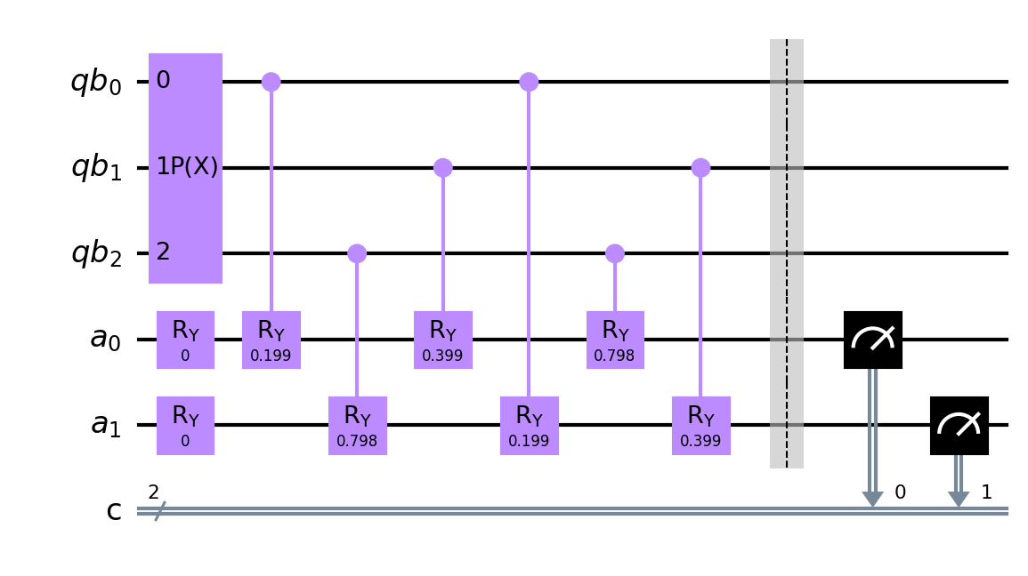
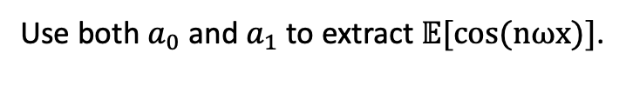
Parellizations
Reduce the shots required by using more ancillas.
Speed up of N
Use both $a_{0}$ and $a_{1}$ to extract $𝔼[cos⁡(nωx)]$.

Slide 12
Distributing the load to multiple machines/QPUs
Qubit
Qubit
A higher discretization requires a number of qubits
Not possible on only one QPU currently
Requirement to distribute this onto multiple machines
This can be realized in two ways:
Common ancillas for different qubits
and/or
Common qubits for different ancillas
Ancilla
Qubit
Ancilla
Ancilla

Slide 13
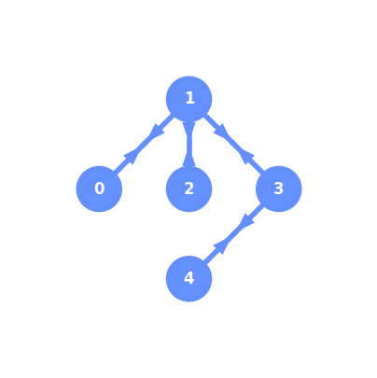
Noise optimization
Created the fire-opal code to compensate noise.
2 day wait on the least used QPU.

Slide 14
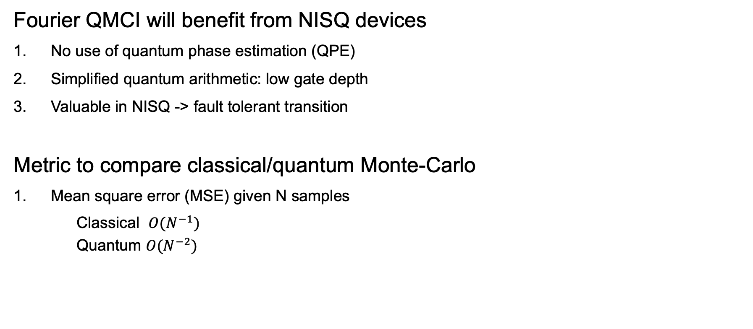
Benchmarking
Fourier QMCI will benefit from NISQ devices
No use of quantum phase estimation (QPE)
Simplified quantum arithmetic: low gate depth
Valuable in NISQ -> fault tolerant transition
Metric to compare classical/quantum Monte-Carlo
Mean square error (MSE) given N samples
Classical $O(N^{−1})$
Quantum $O(N^{−2})$
[1] Herbert, S. (2022). Quantum Monte Carlo integration: the full advantage in minimal circuit depth. Quantum, 6, 823. [2] Woerner, S., & Egger, D. J. (2019). Quantum risk analysis. npj Quantum Information, 5(1), 15. [3] Stamatopoulos, N., Egger, D. J., Sun, Y., Zoufal, C., Iten, R., Shen, N., & Woerner, S. (2020). Option pricing using quantum computers. Quantum, 4, 291. [4] Intallura, P., Korpas, G., Chakraborty, S., Kungurtsev, V., & Marecek, J. (2023). A Survey of Quantum Alternatives to Randomized Algorithms: Monte Carlo Integration and Beyond. arXiv preprint arXiv:2303.04945.

Slide 15
Quantum Hackathon
Thank you! Moody’s and everyone!

